Slide 1


Cx Perceived Value & Affordability in NV
(acp-confidential-cadoc)
Understanding the mental math that Cx complete when shopping for NV on DoorDash.
May 2022
Questions? DRI: Kelly Peterson

Slide 2
Key Insights
1
2
3
Cx want to get the best deal, but ensure things are fair. Most are unsure how all parties make money.
Most Cx weigh convenience over necessity when deciding to use DoorDash
Most Cx do not realize that Dx are doing the shopping
Most Cx assume that the process is similar to Rx and therefore feel fees and tips should be the same.
Things like time saved or money that isn’t spent on gas can be cancelled out if there is an upcoming shopping trip or the overall cost feels to high
They assume DoorDash makes money through advertising, fees and commissions
4
5
6
Most Cx prefer fees over inflation
Most Cx view tipping as a thank you.
Cx want subscription services, budgeting tools or rewards.
Cx want to feel like they are getting the greatest deal and the most for their money. Subscriptions like Amazon & Walmart and awards programs like Uber Eats (Marriott points) help Cx feel better about their choice to spend.
They acknowledge that they need to pay a premium for convenience, but feel it is not longer worth it when combined fees get into the $7-$10 range.
Cx interviewed typically consider how long it takes and the distance the driver has to go.

Slide 3
Background & Methodology

Slide 4
Research Objectives
Understand how Cx perceive cost when shopping NV on DoorDash and the mental math they must complete while shopping
1.
What factors/trade offs to Cx make while shopping?
2.
How do Cx perceive existing fee/tip structures and what do they feel is fair?
3.
What can DoorDash do to ensure that Cx feel satisfied with the affordability of their shopping experience?

Slide 5

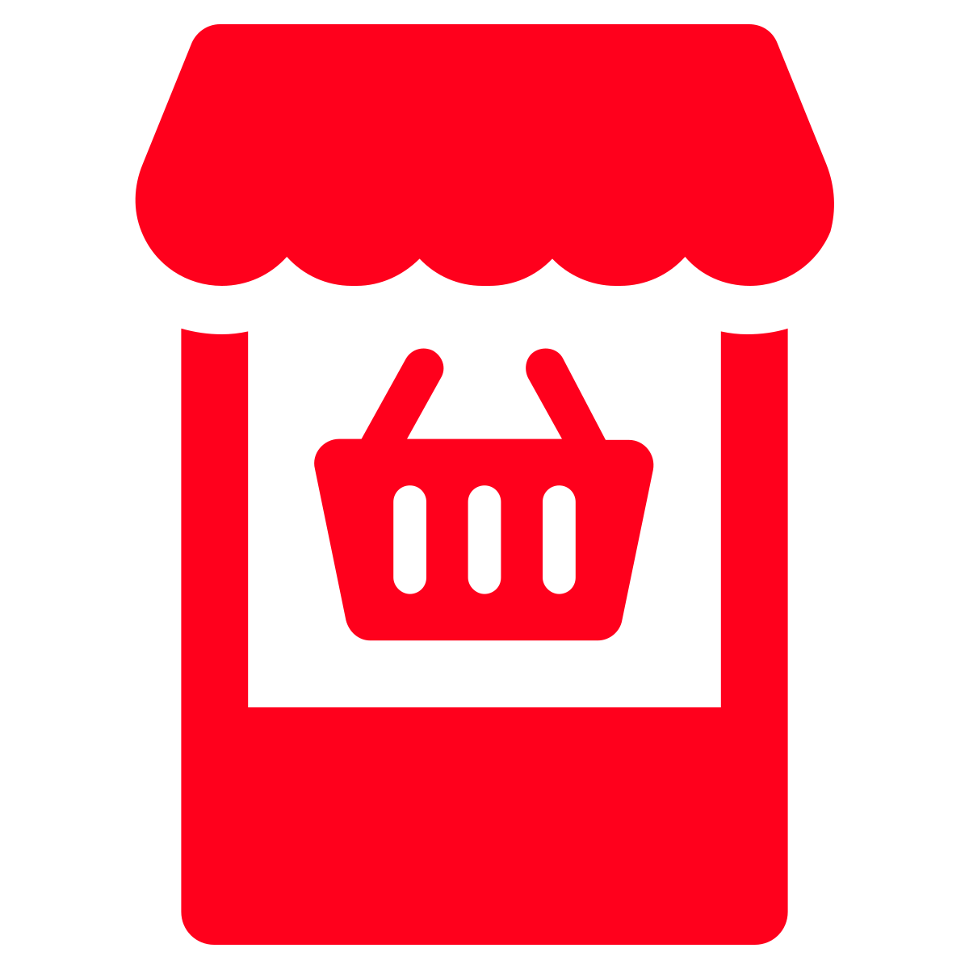
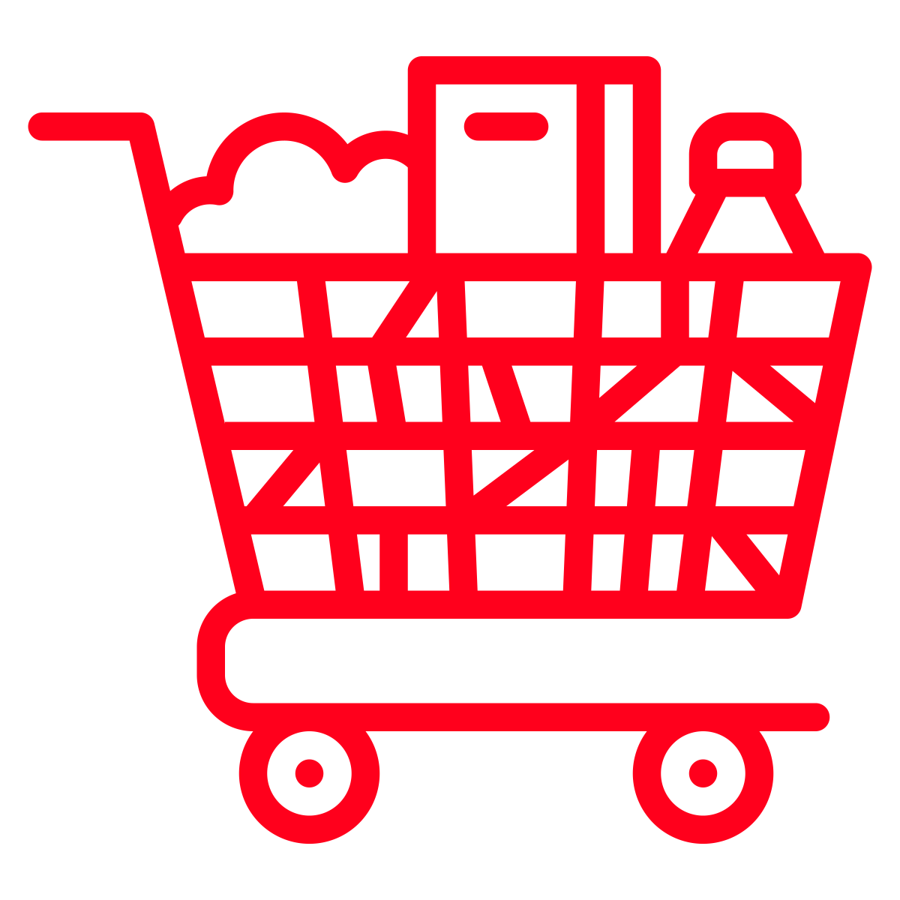
Research approach
DIARY STUDY
IN-DEPTH INTERVIEWS
6 day video diary: April 2022
Participants had to do both a small (top-off) shop and a larger full shop on their own time during the 6 day period. Respondents were assigned either a grocery track or home goods track. Respondents were asked to share feedback on their experience with no specific cost related prompts provided*.
30 min 1:1 Interview: May 2022
A subset of respondents were selected to participate in a deep dive conversation on why DoorDash is perceived as expensive, what is fair, and how they think about cost when shopping for NV categories on and off the DoorDash app
N=27 Participants
(n=13 retail, n=14 grocery)
Includes a mix of 1st time NV shoppers and existing NV Cx
Balanced for geography, age and gender
N=11 Participants
(n=5 retail, n=6 grocery)
Includes a mix of 1st time NV shoppers and existing NV Cx
Balanced for geography, age and gender
Skews Cx who completed retail
Skews Cx who completed grocery
*Additional shop-ex feedback to be provided in upcoming memo

Slide 6

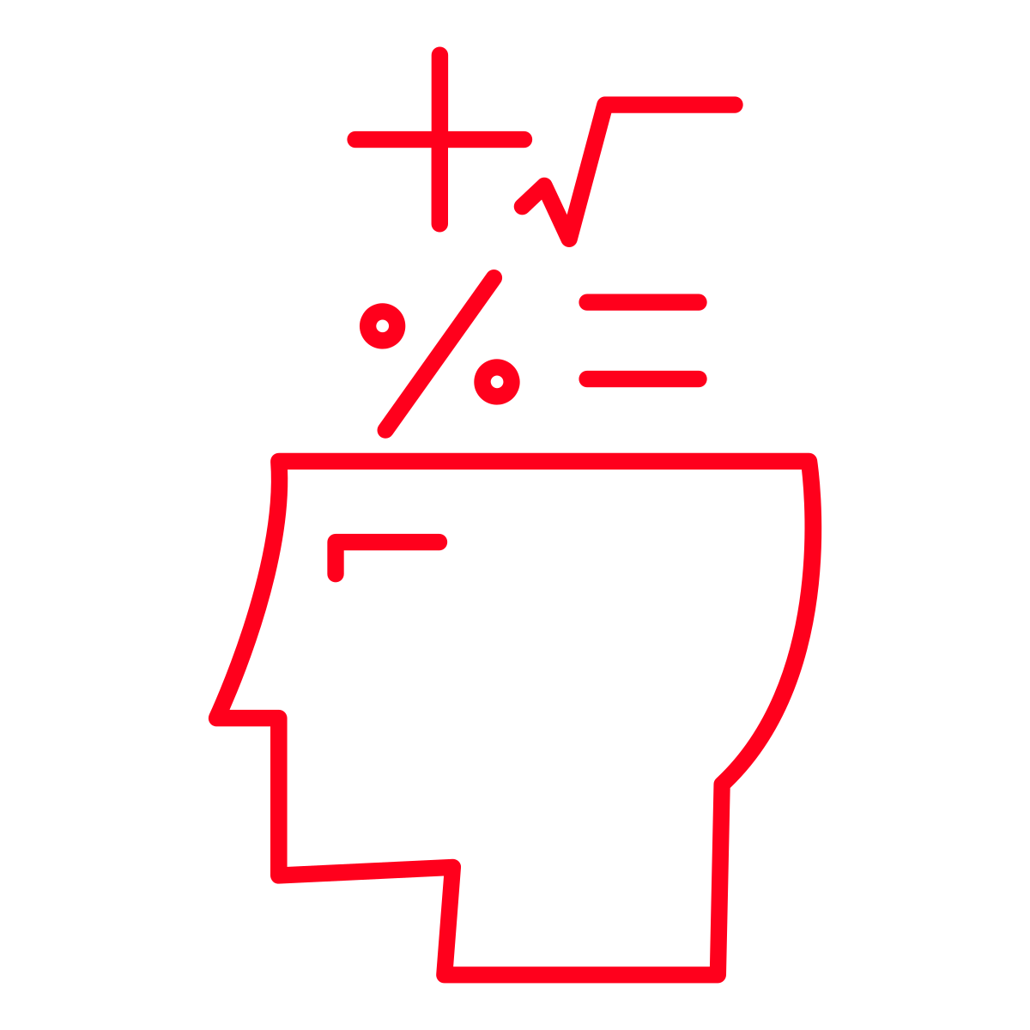
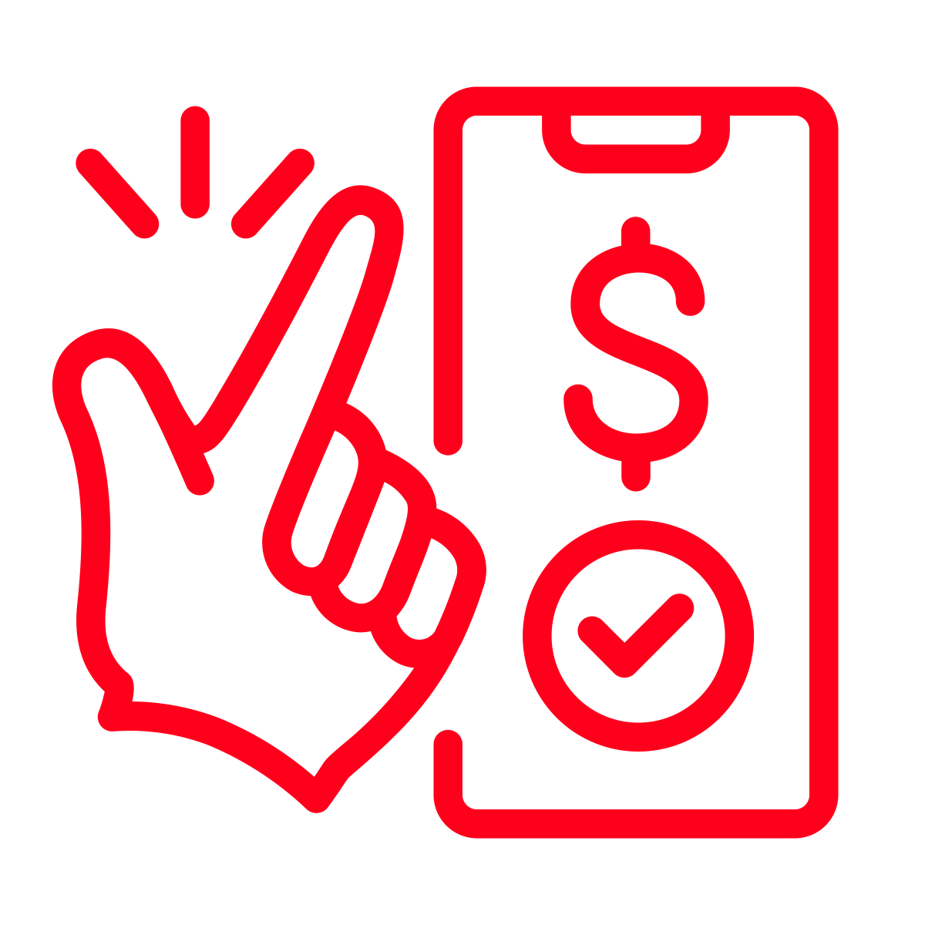
Covered today
1.0 Cx perceptions
2.0 Shopping considerations & mental math
3.0 Making the mental math easier
Expectations
Drivers of expense
How it all works
Factors for and against shopping on DoorDash
Thoughts around fees, inflation and tipping
Cx recommended services

Slide 7
Cx perceptions

Slide 8
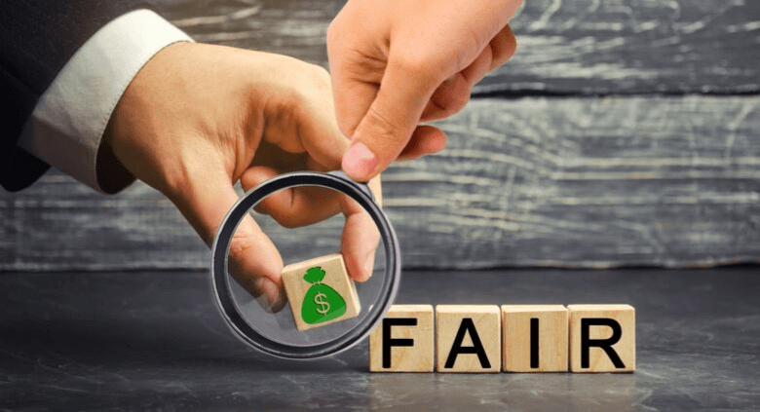
“I want to pay as little as possible…but I also want it to be fair”
What does fair mean to Cx?
I get my order that I want, on time
The Dx is paid properly
High gas prices are considered
DoorDash can “keep the lights on”

Slide 9

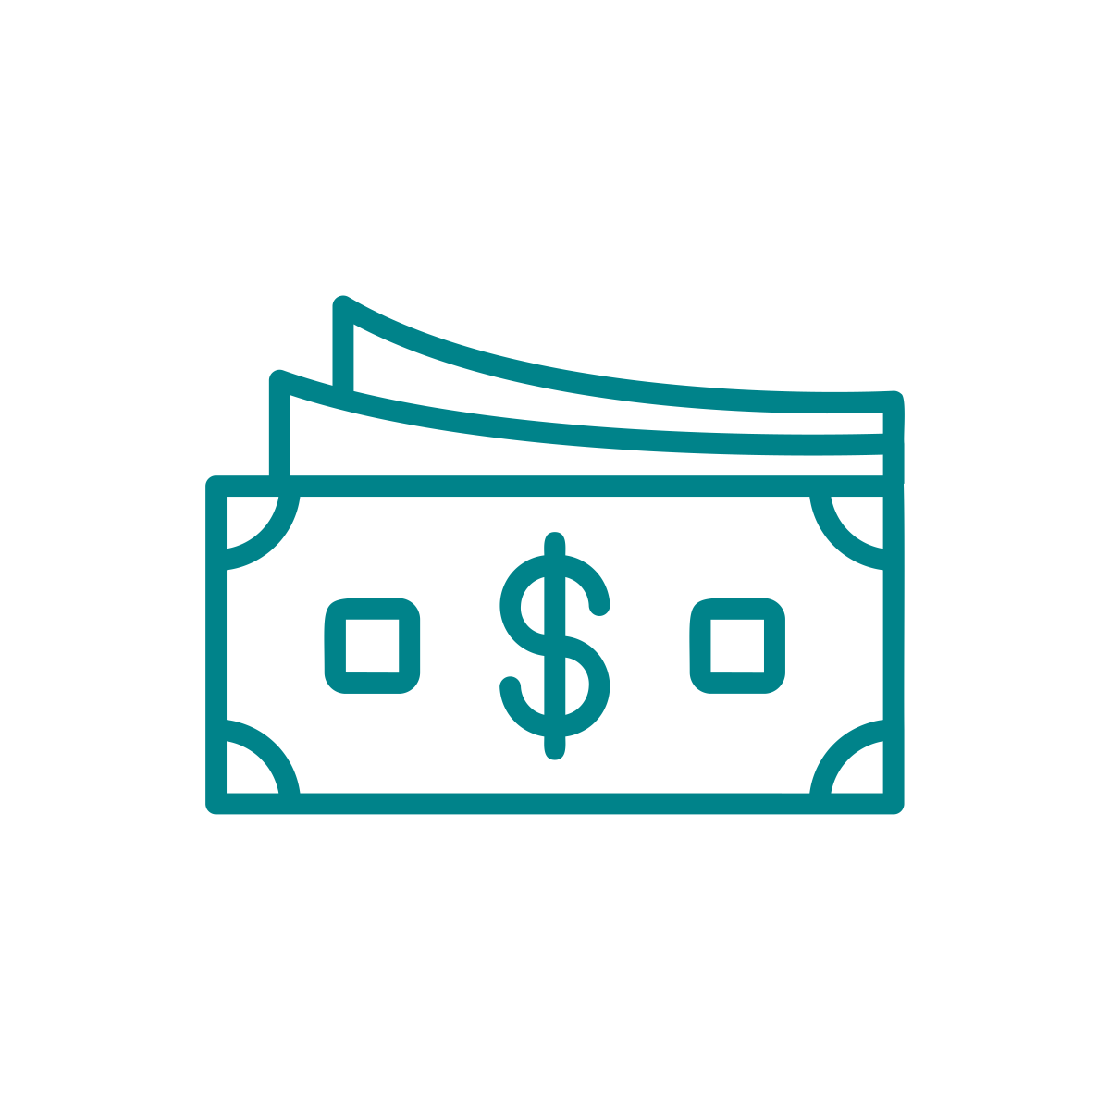
Most Cx struggle to communicate why they perceive as expensive
Interviewed Cx can’t quite put their finger on what is driving the feeling of expensiveness
Instead they describe a mix of…
Fees
Inflation
Selection of stores (stores that are more expensive)

Slide 10
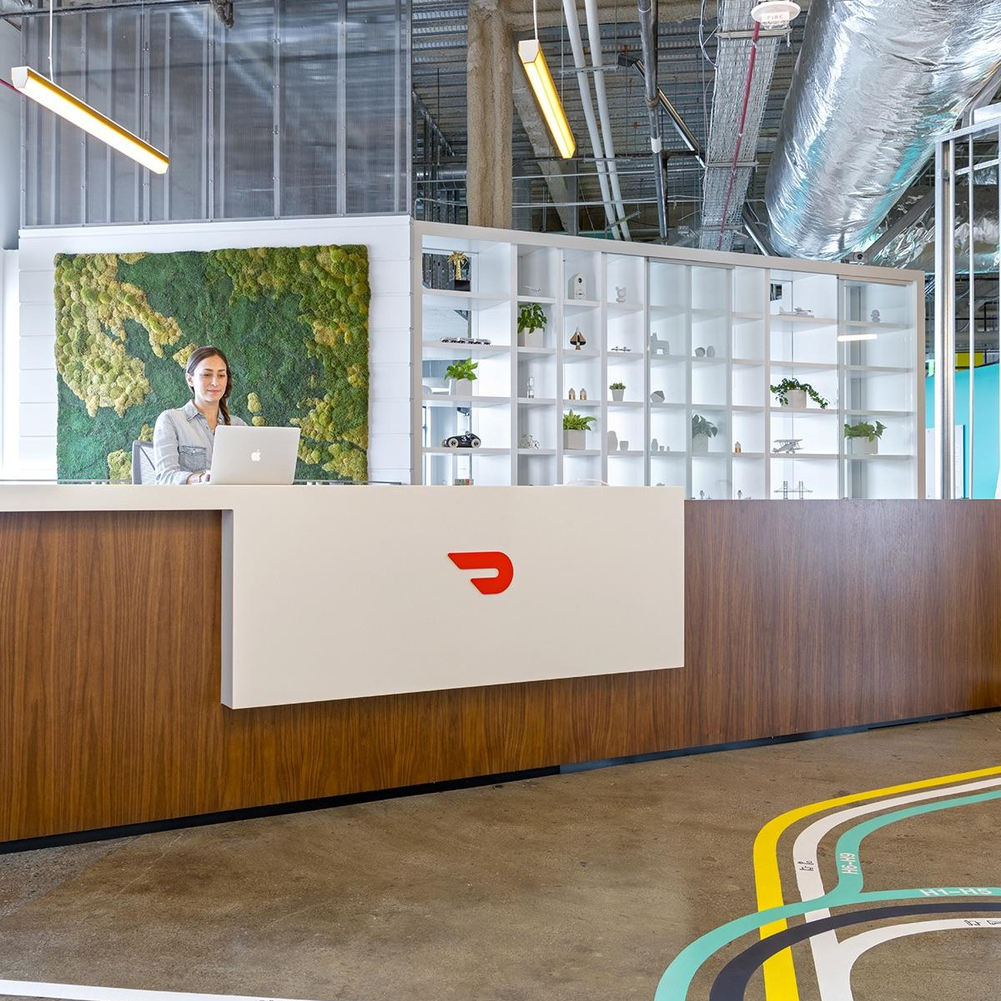
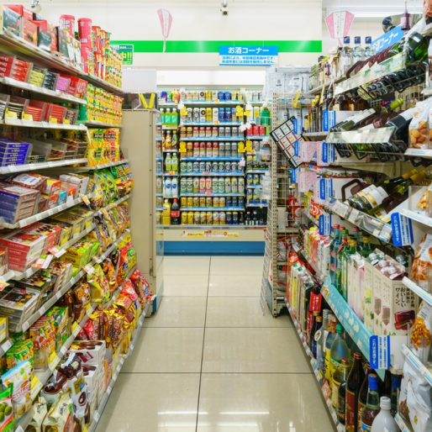
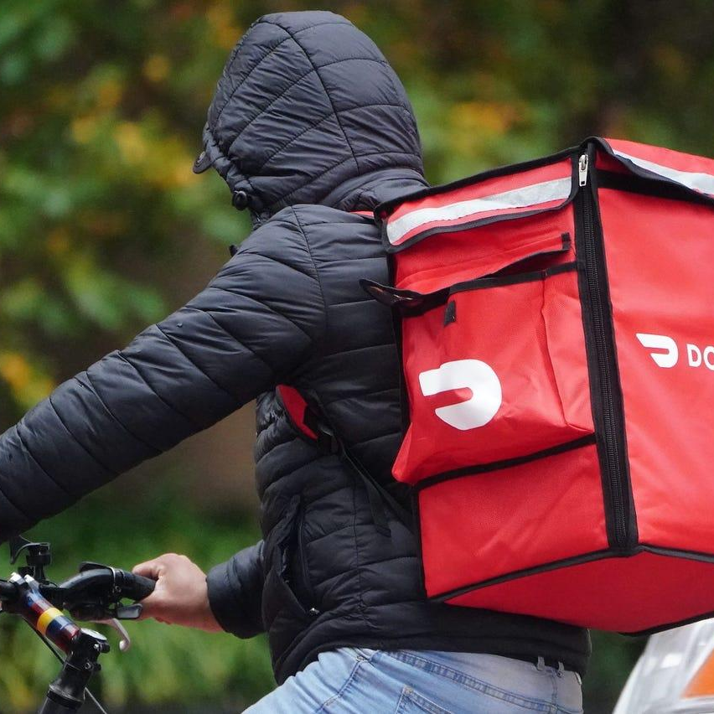
Most Cx are unsure of how all parties make money
DoorDash
Merchants
Dashers
Advertising
Commissions
Cx fees
Sale of item
Cx fees
Tips
DD pay
Maybe Cx fees

Slide 11
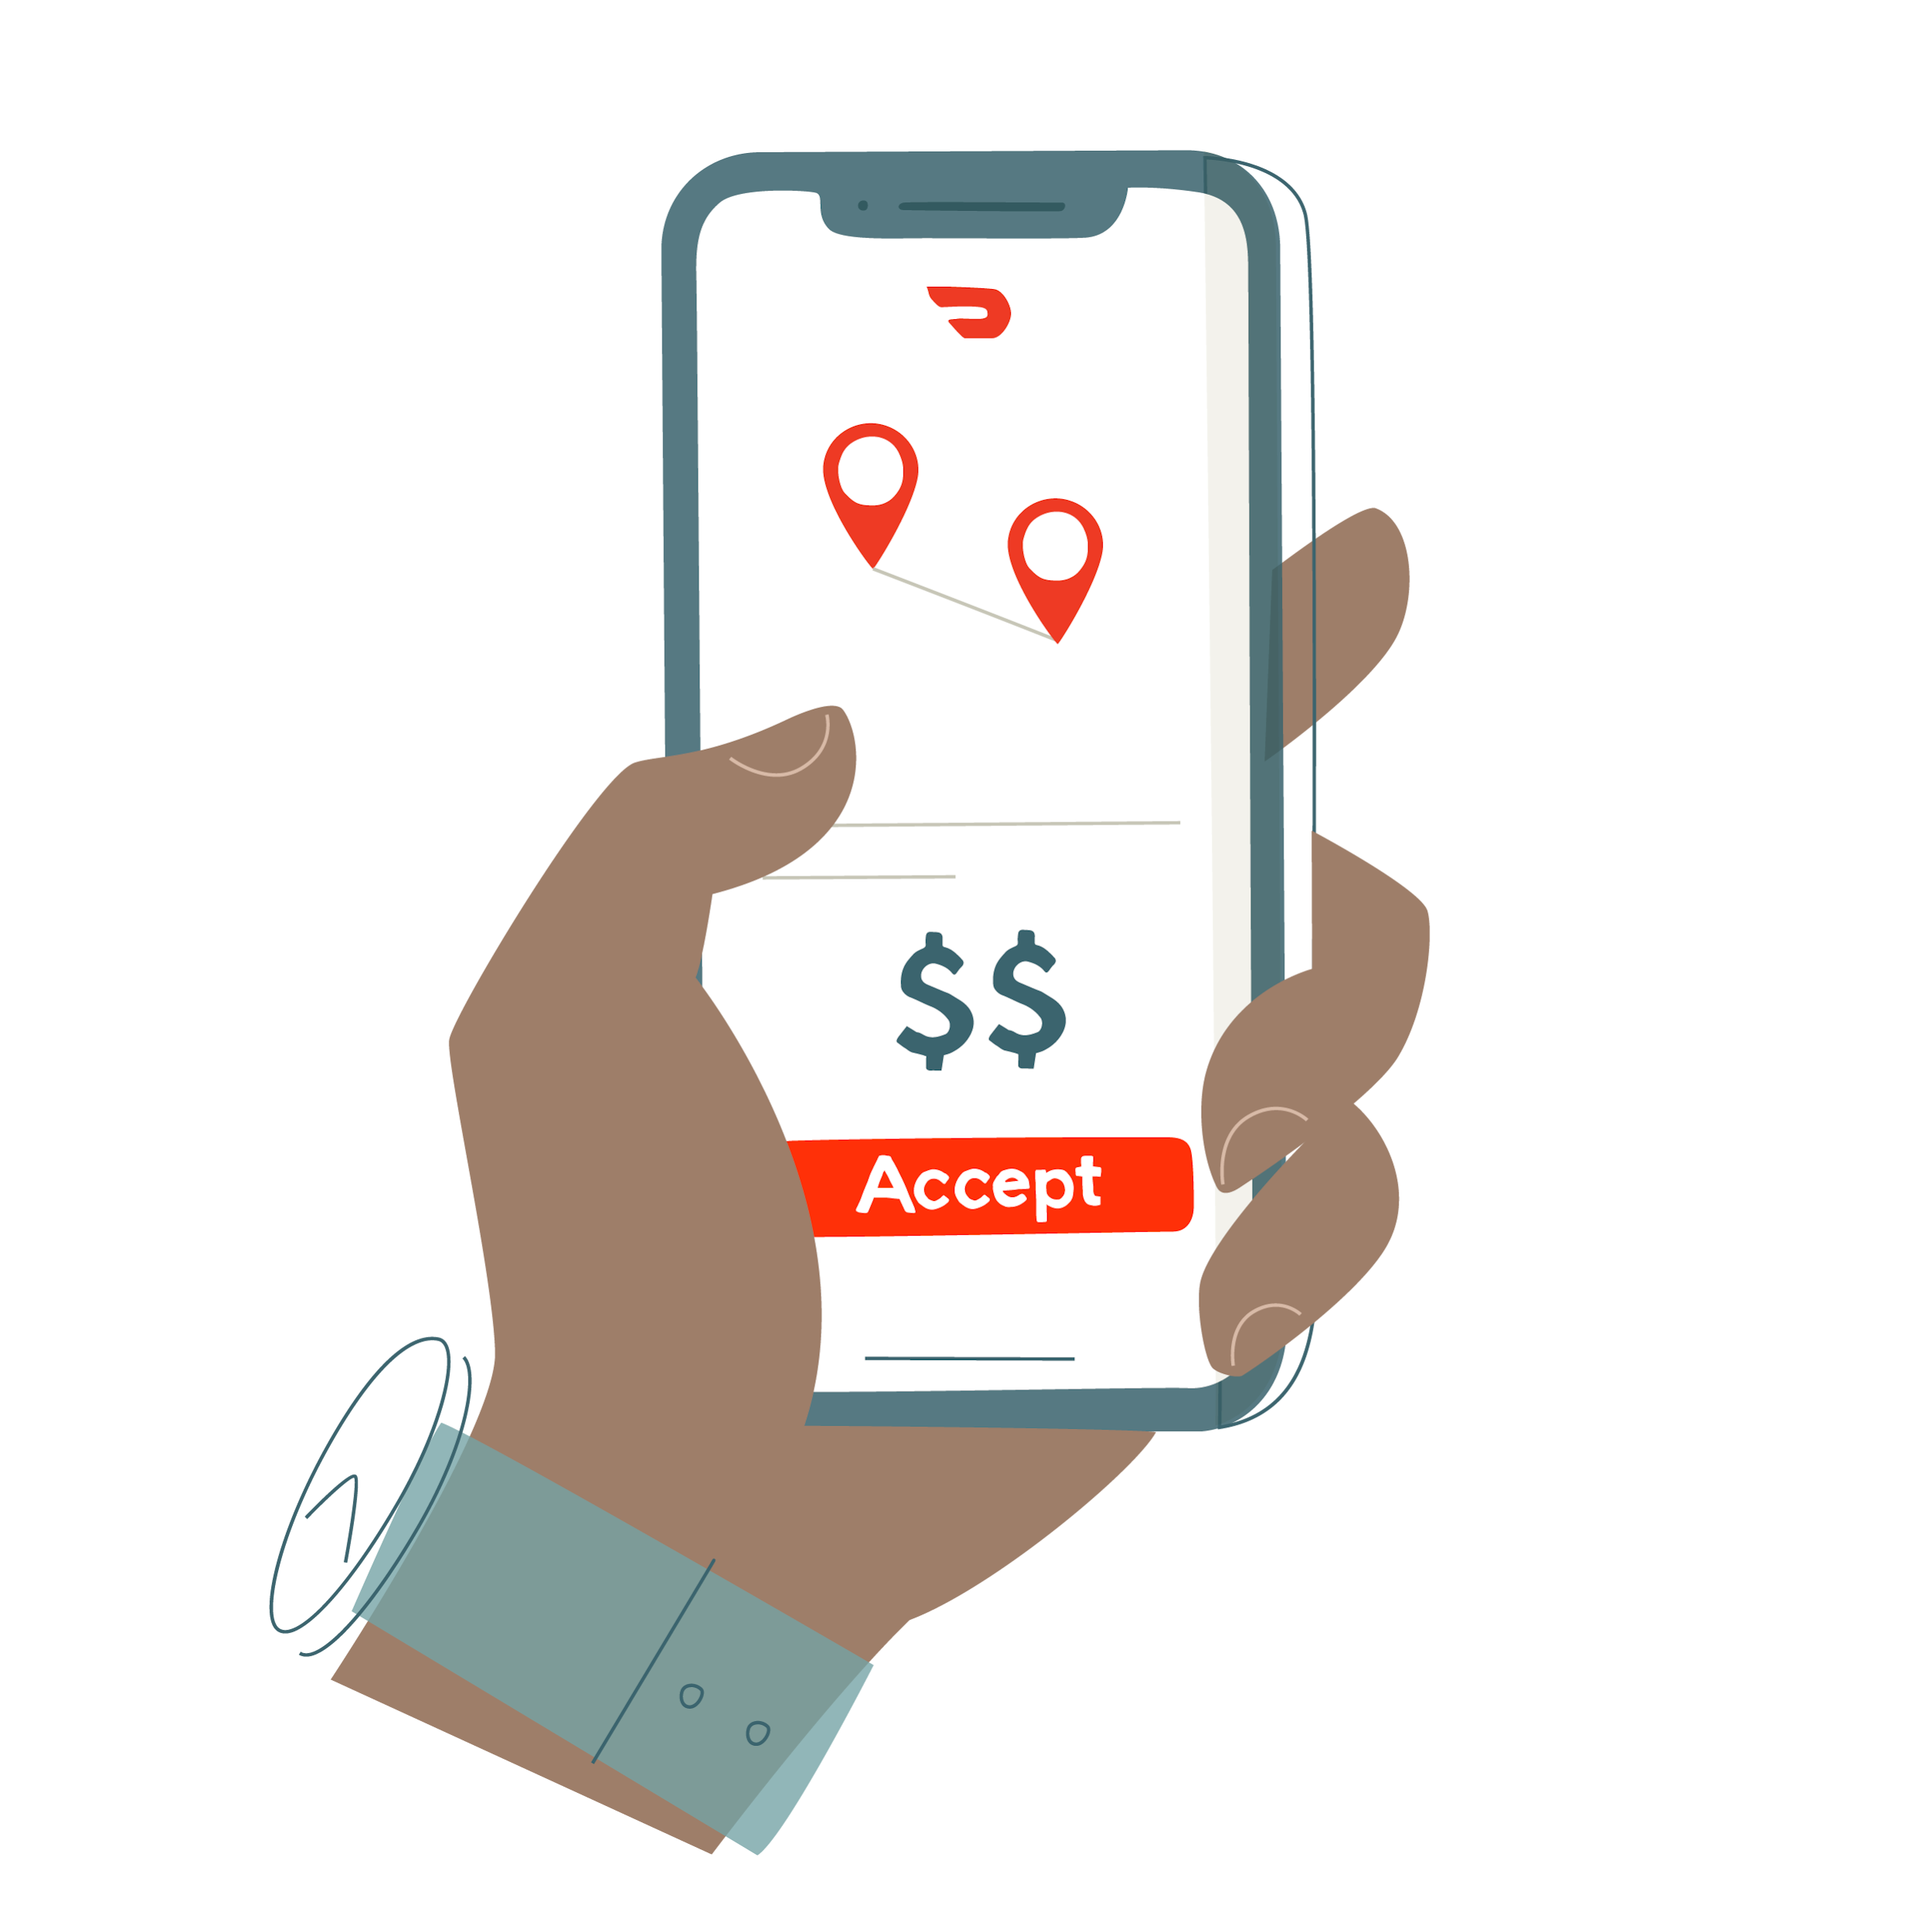

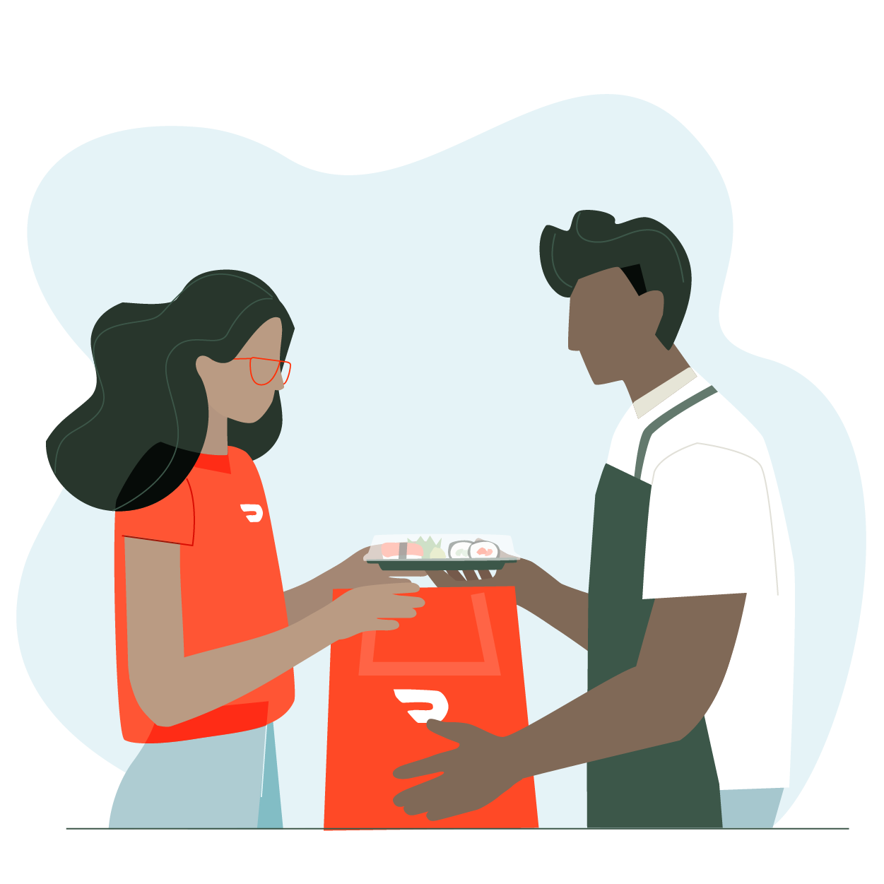
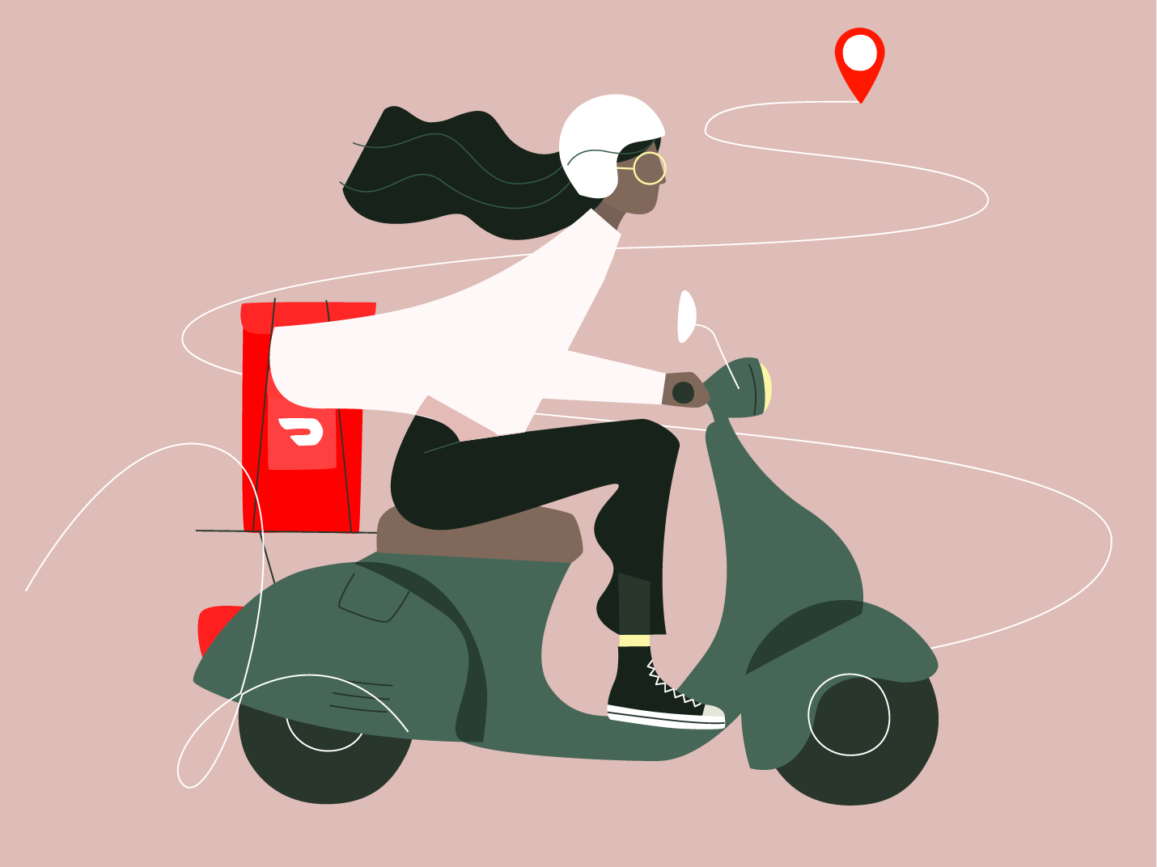
Most Cx are not aware that Dashers shop in store
Dx experience according to Cx:
Only 1 out of 15 Cx that participated in the deep dive conversation knew that Dx have to shop in store for their order…
Accepts order on app
Picks up pre-shopped items from Mx
….Therefore, Cx feel the fees & suggested tips should the same as Rx (regardless of order size)
Delivers to Cx

Slide 12
Shopping considerations & mental math

Slide 13
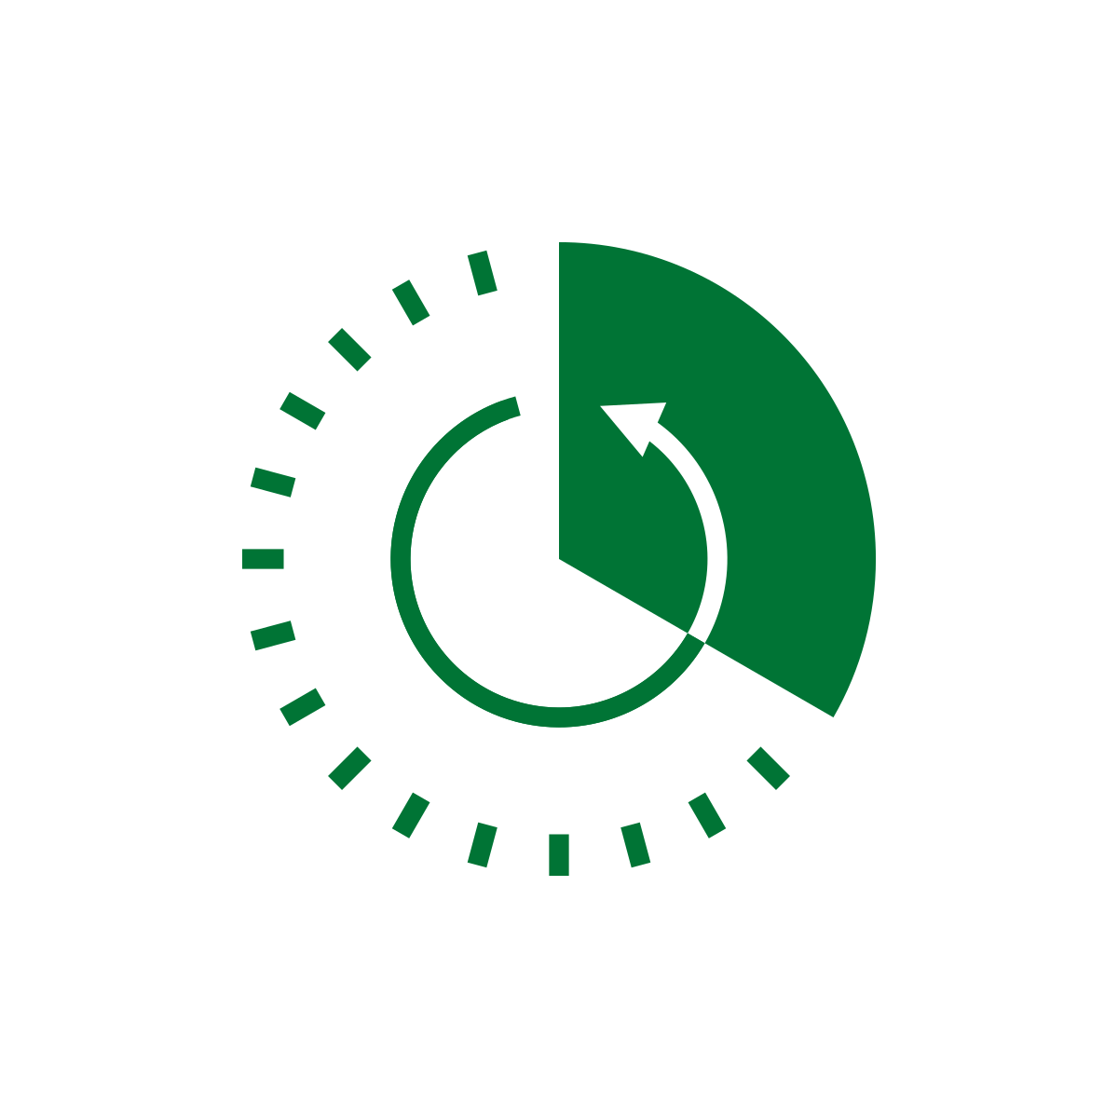







Convenience factors such as time spent & current energy level are top considerations to shop on DD instead of in-store
Top considerations for shopping on DoorDash:
 | Time spent/saved |  | Mode of transport
 | Distance to store |  | Energy level
 | Weight of order/# of items |  | Time of day/popular times for store
 | Price of gas |  | Time until order arrives
Skews Cx who completed retail
Skews Cx who completed grocery

Slide 14
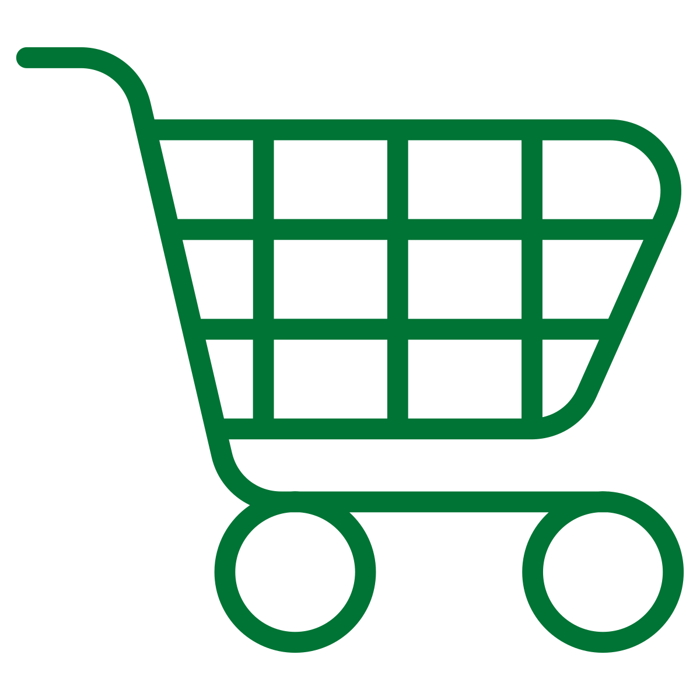


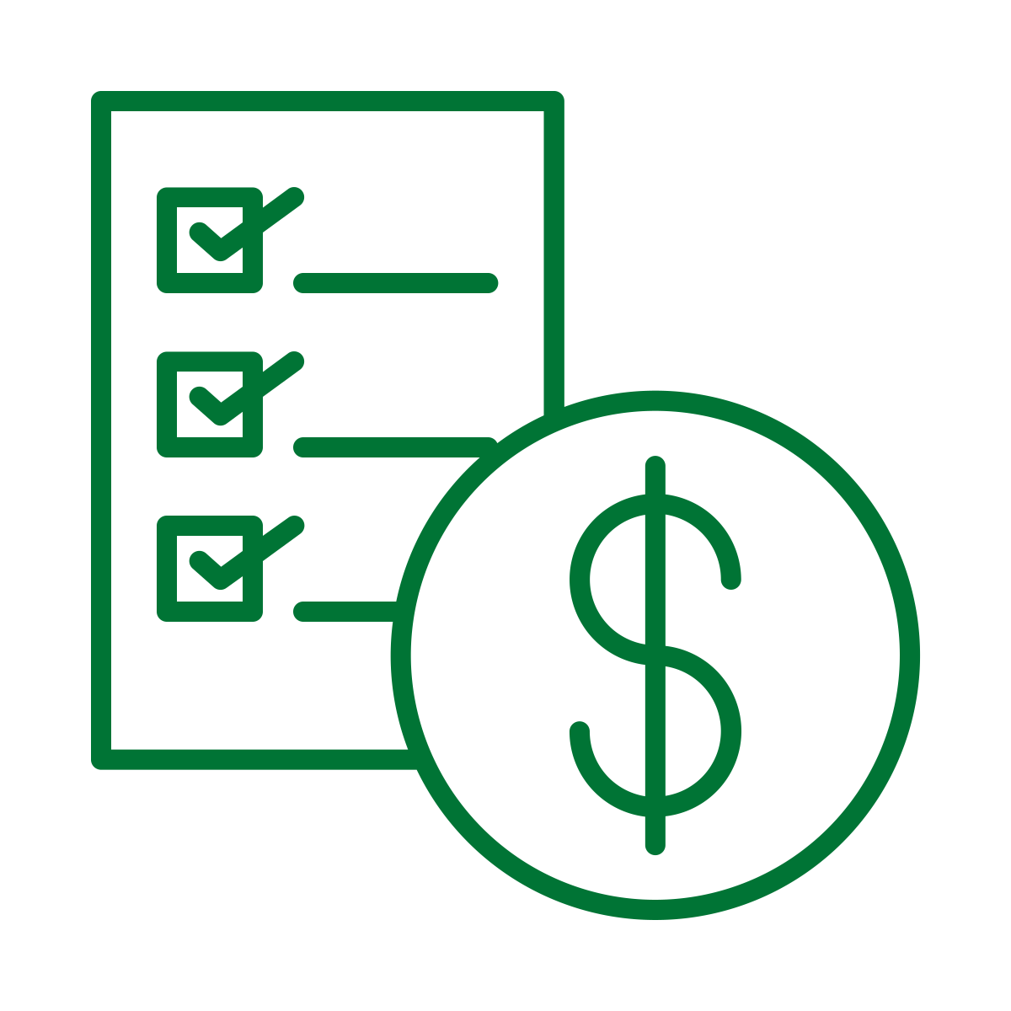
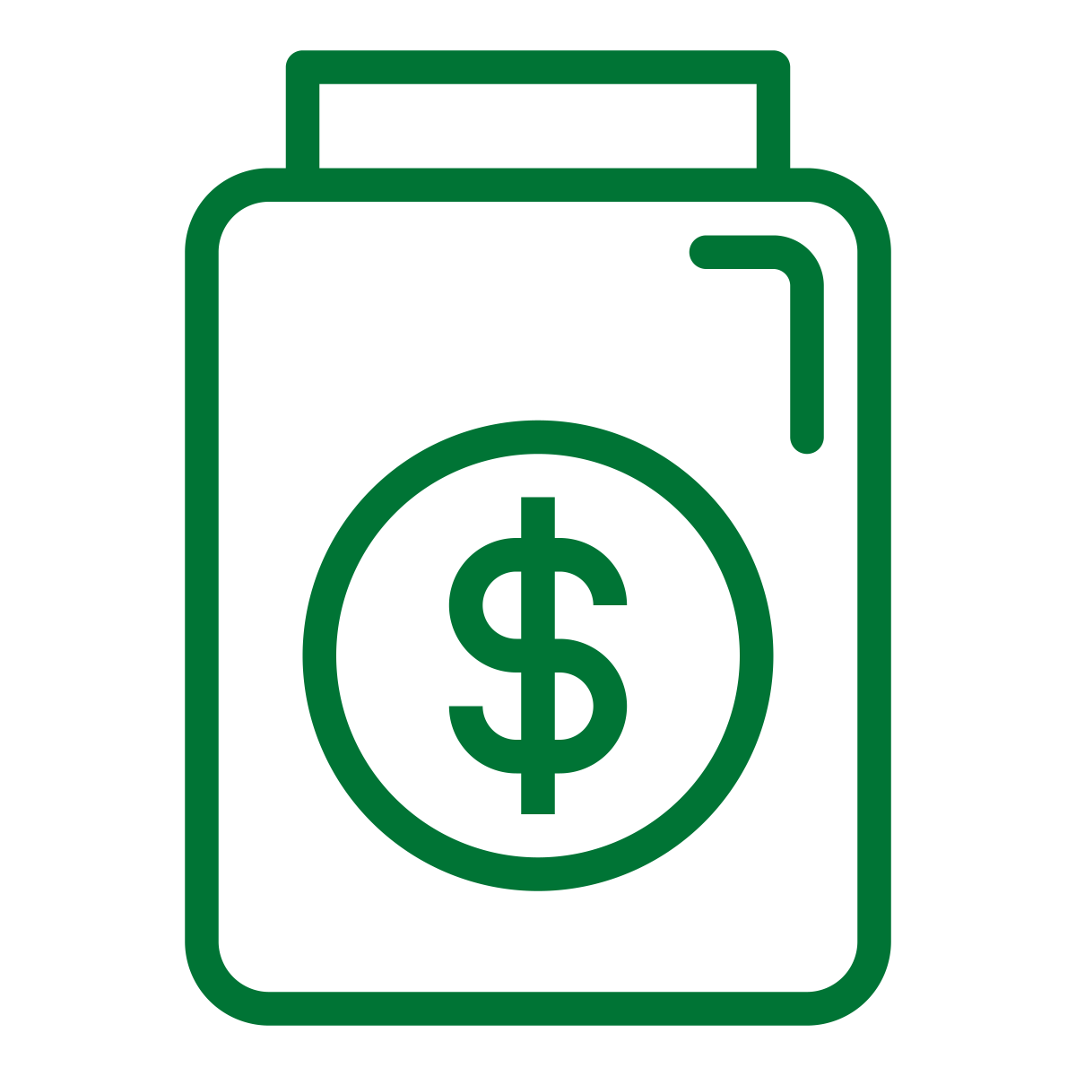
There are several questions Cx ask themselves before feeling confident making a NV purchase
Do I have a shopping trip coming up soon? | Is this an immediate need? | Does the price seem/feel right? | Are the fees too much? | How much will I need to tip?
Skews Cx who completed retail
Skews Cx who completed grocery

Slide 15
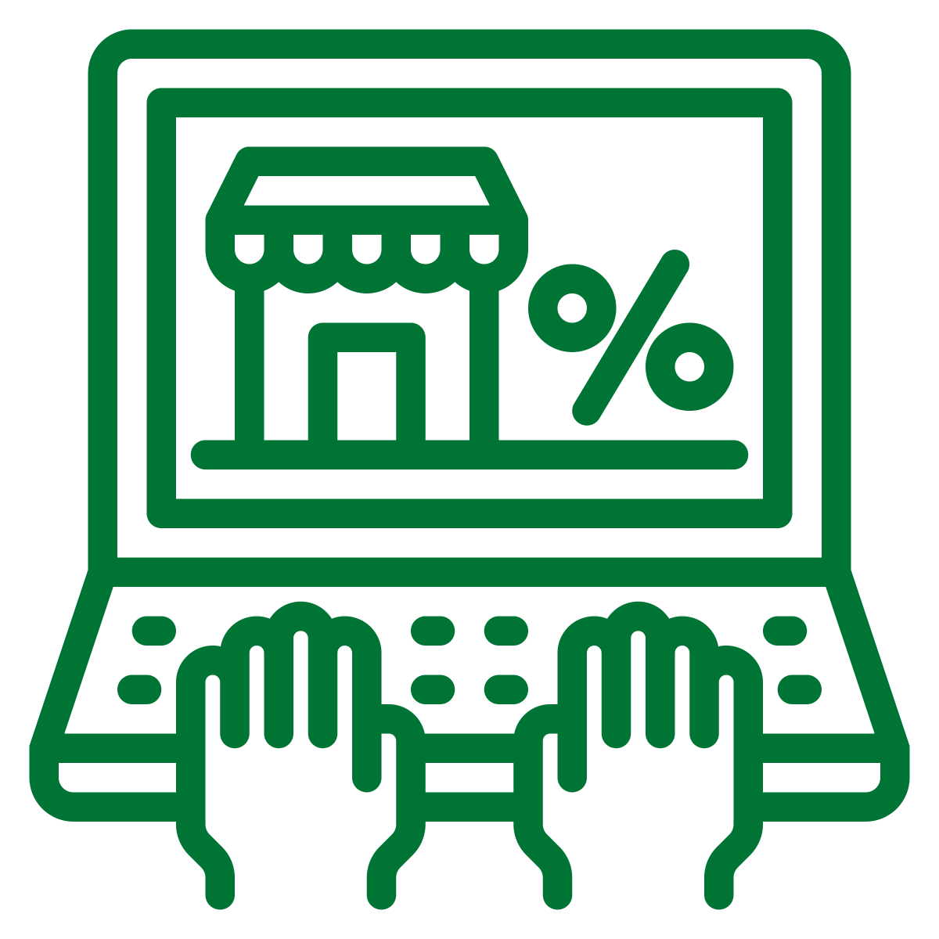


Inflation is more likely to impact online shopping behaviors
When experiencing inflation when shopping in-store, Cx will end up completing their purchase to avoid another trip to the store
When shopping online (not specific to DoorDash); Cx are more likely to question their purchase and look for lower prices elsewhere
Eggs was the most frequently identified item for inflation in-store

Slide 16
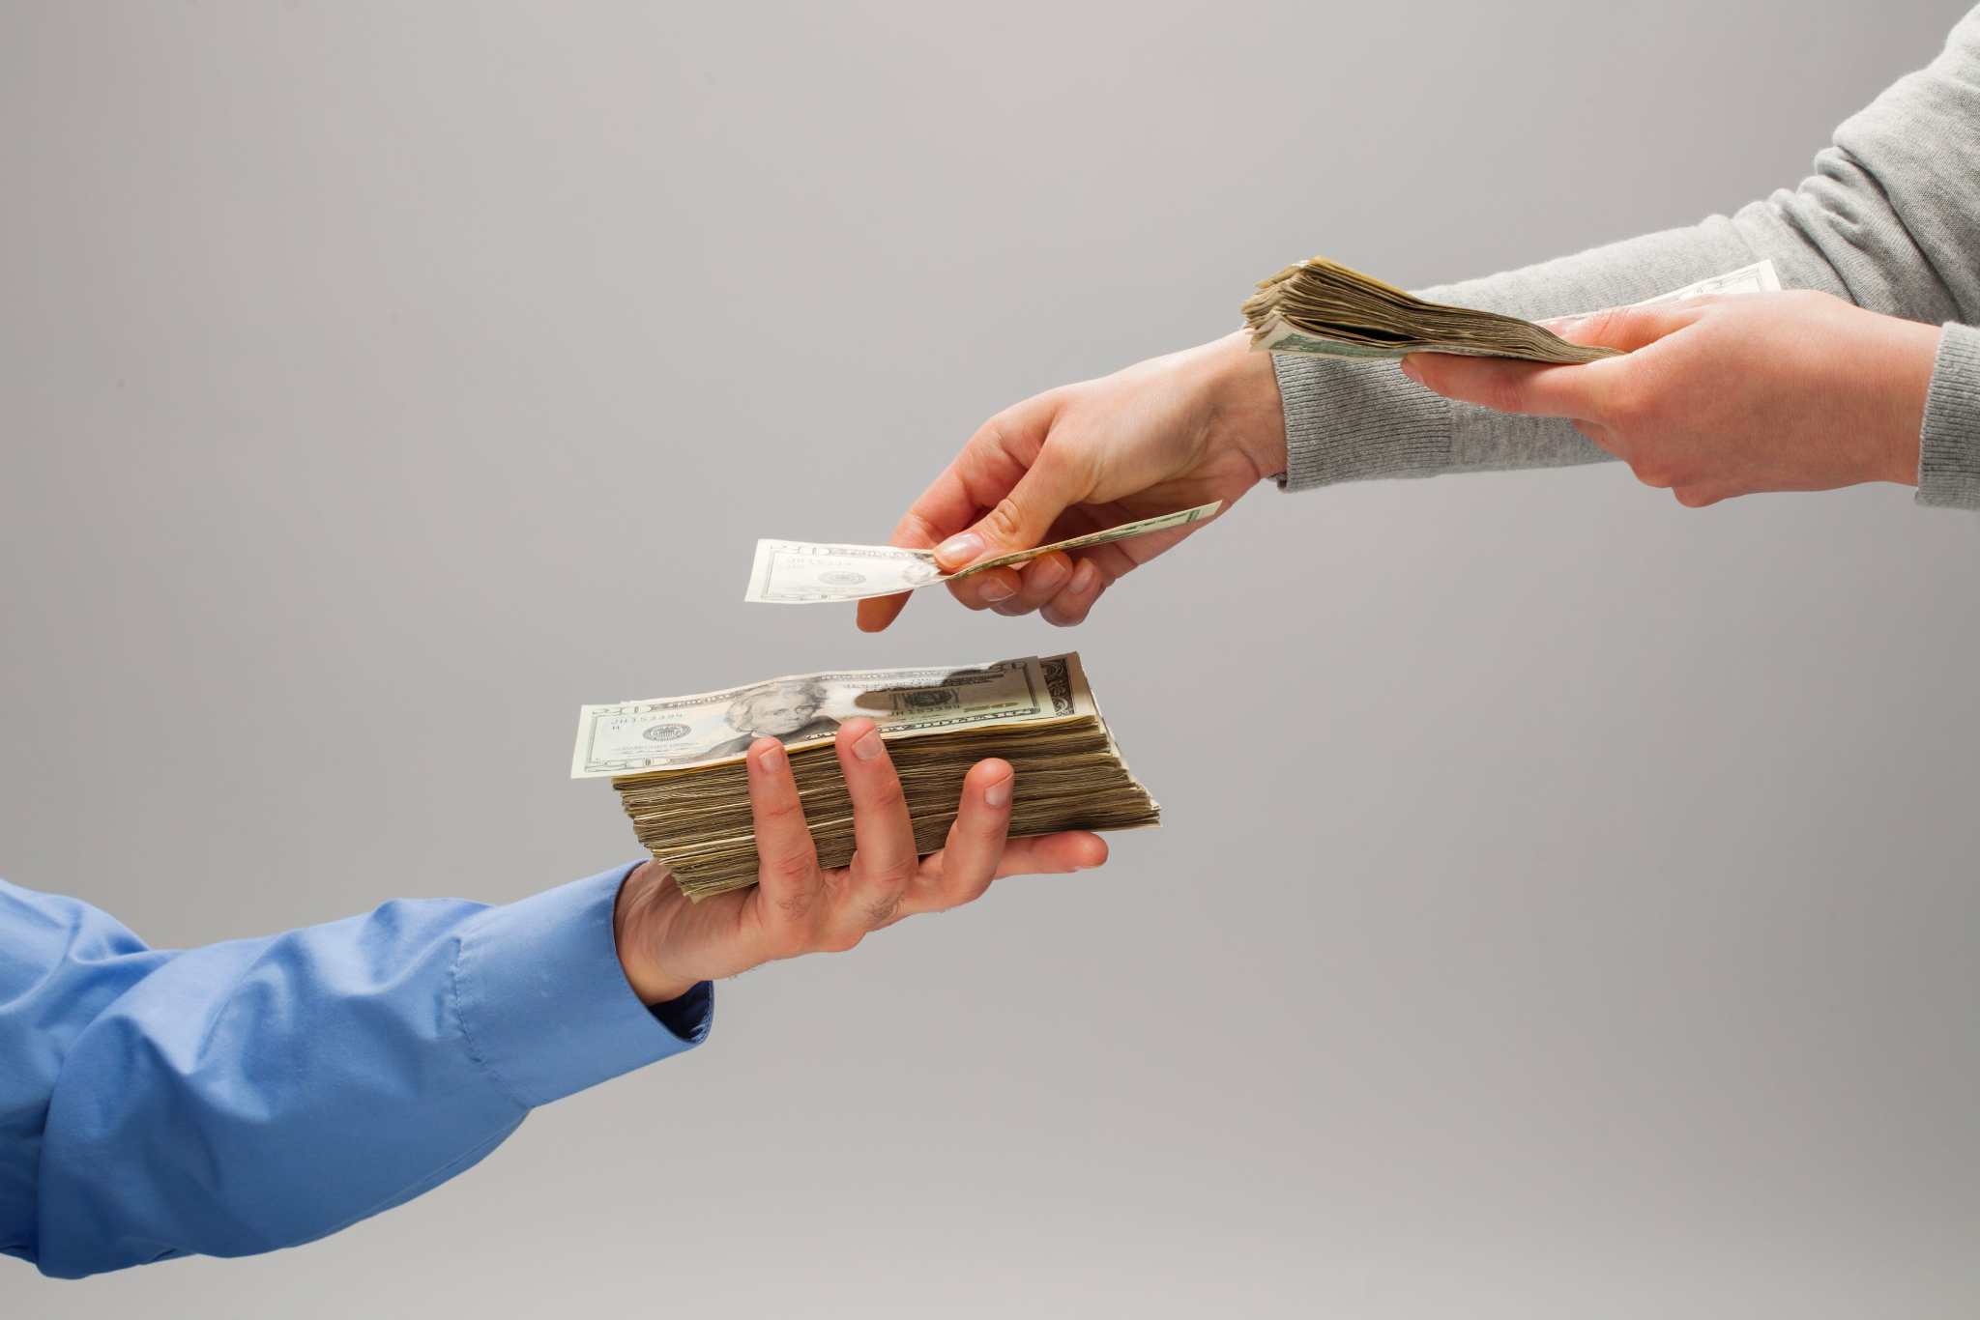
Most Cx prefer fees over inflation

Slide 17
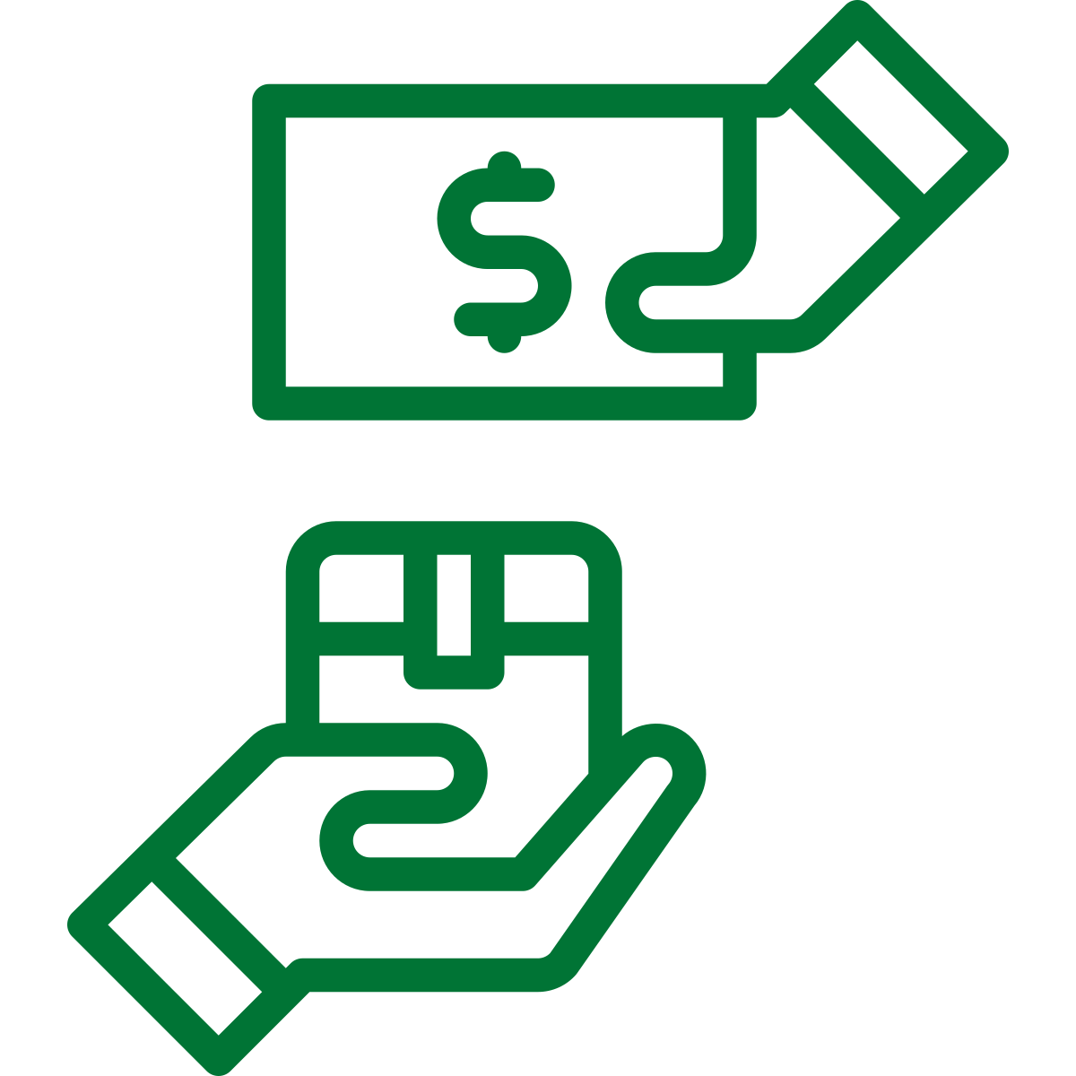
Most Cx expressed preference for flat fees
Specifically, Cx want to know why delivery fees remain consistent and service fees change significantly from order to order
Cx feel each individual fee is fair, however, when added to total along with tip, it becomes too much
Overall Cx acknowledge they have to pay a premium for convenience
Delivery fees are viewed as extremely fair with today’s high gas prices
Fees feel most burdensome on smaller orders
Fees should be a sliding scale, as you spend more money the proportion should go down
$7-$10 in fees is the tipping point where Cx start to evaluate the situation/triggers mental math
Cx interviewed would prefer to see flat fees that account for the size of the order

Slide 18
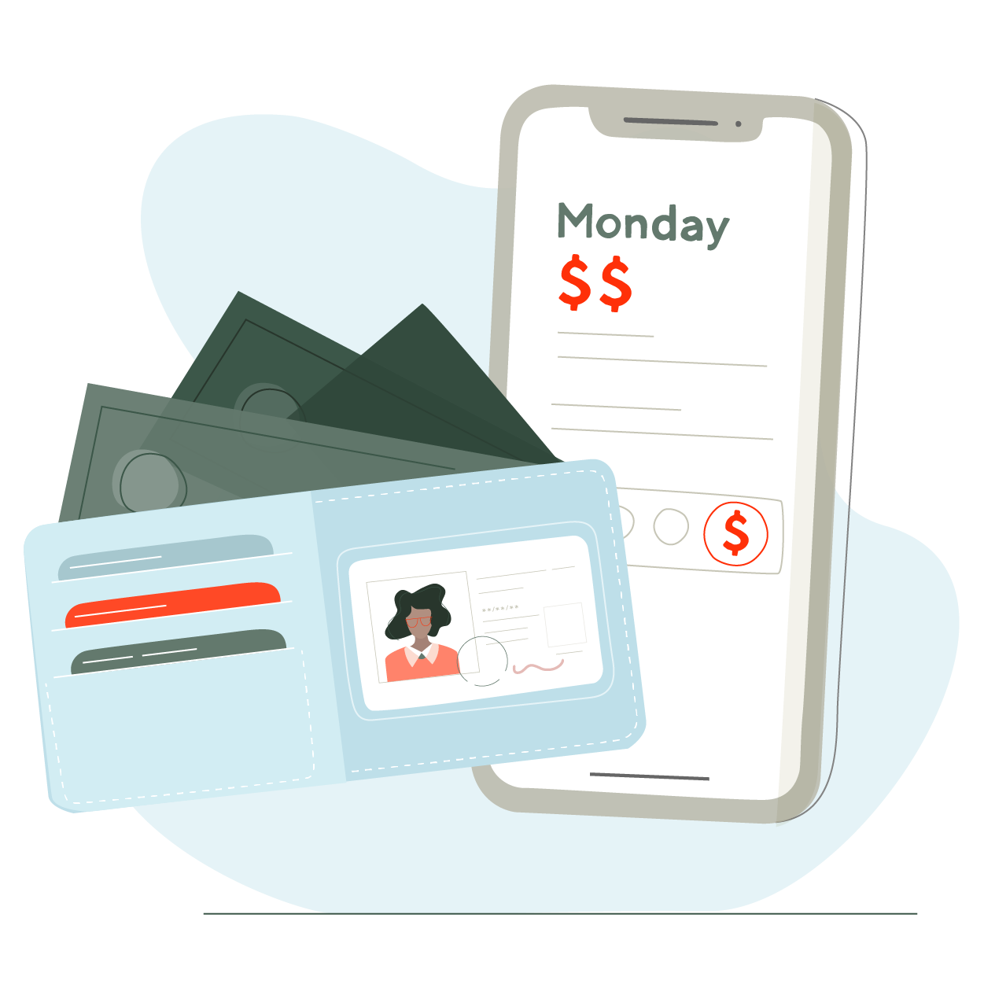
20% is ideal, but not realistic
For the majority of orders interviewed Cx skip the math and go with the recommended tip, but that doesn’t always align with their “gut feeling” on tip
Most Cx say they will tip 20%, but also assume tip should be similar to an Rx order and in the $5 - $10 range
Most Cx consider tip a “thank you” rather than a form of compensation
Most Cx assume that non-tip compensation is a greater percentage of total Dx compensation than it is
2-3 Cx had delivery driver friends and knew tip is a large part of their pay
Main consideration is distance the Dx has to drive (especially with higher gas prices)
Most Cx do not consider time spent shopping as they are not aware that Dx need to shop

Slide 19
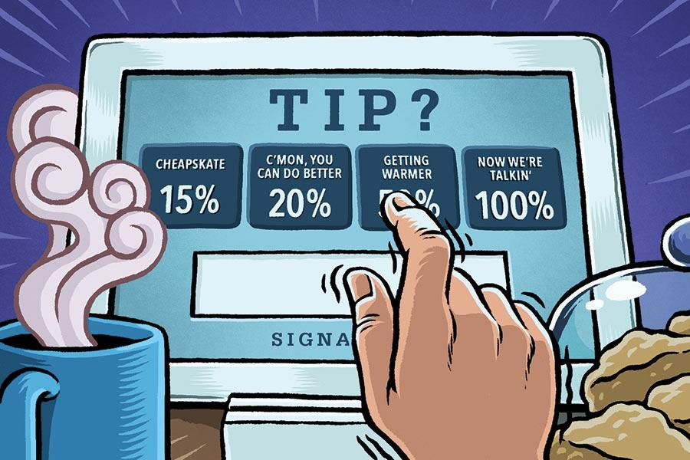
Most Cx do not like that tips show on a separate screen

Slide 20
How can DD make the mental math easier?

Slide 21
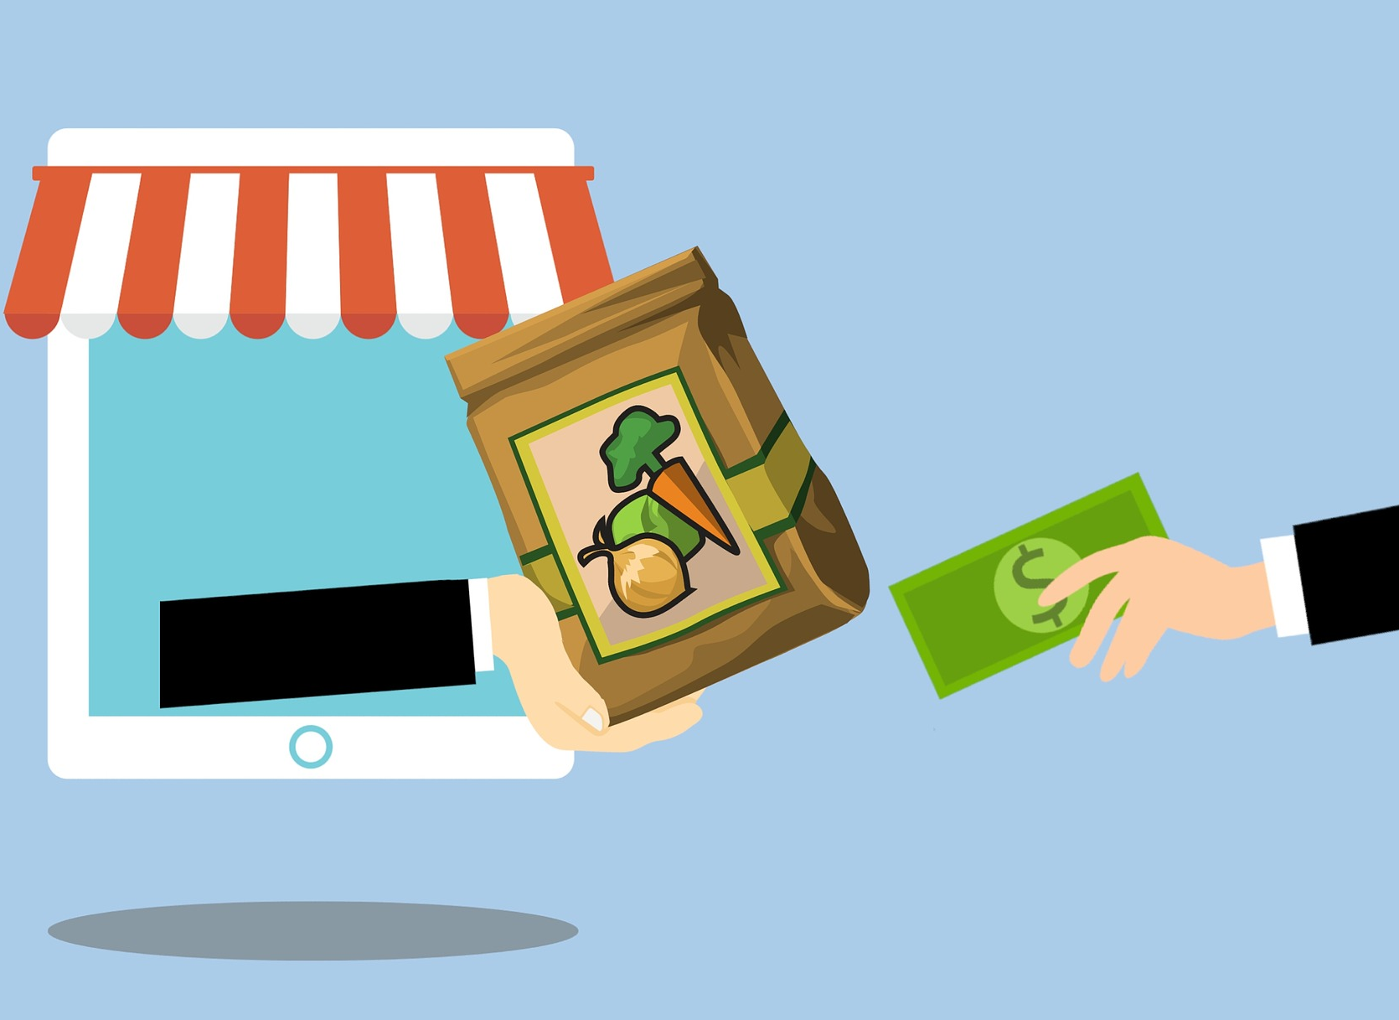
Cx are interested in a subscription model
25% of Cx interviewed mentioned that they would prefer to have a subscription service
Most Cx feel that DashPass helps, but would like the savings to be more consistent
One grocery Cx did the math of his Walmart subscription vs DoorDash fees and said that DoorDash is less expensive, however, he prefers the consistent cost

Slide 22
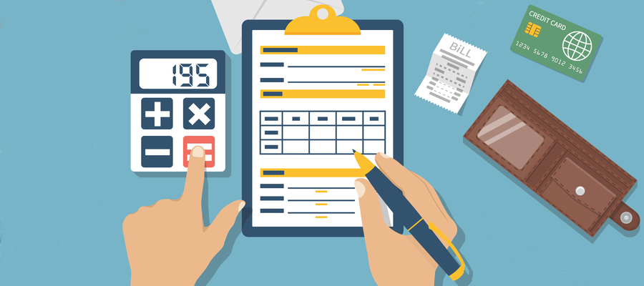
Consider offering a budgeting tool for grocery
A small subset of grocery Cx mentioned interest in a tool that would allow you to see how you’re doing on your budget while you shop
Cx are also interested in having the tool provide suggestions for ways to stay within budget (e.g. one less bag of chips or swapping brands)
While most Cx do not have a strict budget, they shop with a range in mind

Slide 23
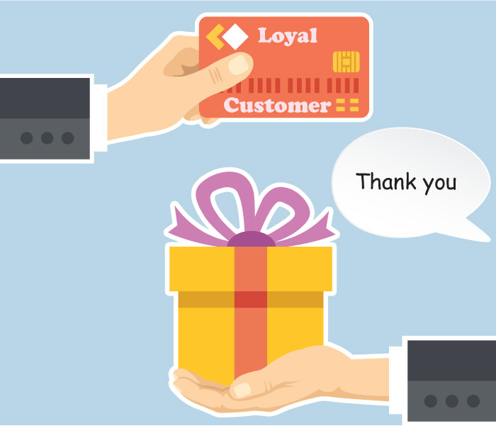
Provide rewards program, and link to other rewards
Highlights savings and credits as much as possible
Provide loyalty program and reward Cx for multiple shops
Allow DashPass use if not currently using Chase card
Connect to other loyalty programs
E.g. one Cx called out that they prefer UberEats because it allows them to get Marriott points, credit card points and points for Uber

Slide 24
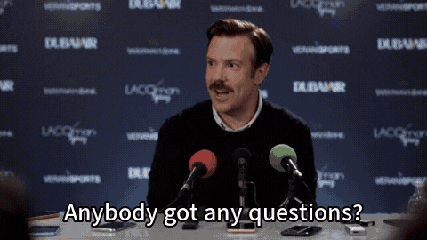
Thank you!

Slide 25
Appendix: Notable quotes

Slide 26
Shopping online vs. in-store | If I’m buying fresher foods like produce or meat for example, I would prefer to go in-store so I can make that decision after comparing prices. I look at a couple different places to see who is having the best deals on the things I'm shopping for. I usually choose whoever is having the best sales and also who delivers the fastest
Loyalty/credits | I have a credit that is applying to this, but I prefer not using it. So I wish there was a way to. Apply the credit at a later time. So that's kind of making me hesitate on making this order right now. I might make a food order first and then make a delivery later once I have gotten rid of that credit. Even though I have Dashpass, I still needed to have a minimum order of $25. So although I didn't need everything right now, I added more to get to that free delivery minimum
Promotions | I first started shopping for groceries on DoorDash because it was a convenient way. And sometimes they do have promotions or it's like 50%. I haven't shopped for big groceries, just like convenient little. Supermarket like 7-Eleven, like just little easy things to get picked.

Slide 27
Tipping | $50. I'll edit the tip. It's raining again. I'm kind of happy. I am happy with what I could see on the checkout. I love that it automatically chooses the what they think is the most adequate tip for the orders based upon, you know, delivery, distance and things like that. When I choose that I had the best rate of drivers actually picking on my orders and delivering them on time So, of course, 15% of the tip is going to be, you know, almost $27, as you see. And it would definitely make me stop in my tracks a little bit of going through with this order because of that when I could just pick it up myself. I'm not saying the driver doesn't deserve that much money, it's that do I really want to spend an extra $30 when I could just make the orders to pick up myself and just go pick it up?
In-store inflation experience | I noticed that a dozen eggs was, I think, around like 3 to $4, which is a little bit surprising to me because I'm used to buying a dozen eggs closer to $2 to 50. So I was a little bit confused as to why that happens. So I still ended up purchasing it just because I wasn't inclined to make another trip to a different grocery store to potentially, you know, price compare. And at Sam's Club, the giant boxes like $40, which it would definitely last me for a while, but $40 is a lot to pay for pull ups. So that was the thing that I was buying or wanting to buy, and it was at Sam's Club, like I said, and I did not end up purchasing the item there just because of the expense. I actually ended up going to target and just buying a slightly smaller pack for a cheaper price just because it fit better into my budget at the time.

Slide 28
Convenience factors must outweigh the costs to justify a DoorDash NV purchase
Time saved
(
(
(
Weight of order
(
+
Distance * Mode of Transport * Gas
+
+
Energy level * Time of Day
Time of arrival
(
(
Urgency of Need * Price Inflation * Fees * Tip

